Slide 1
Artificial Intelligence and Security
SLIDE HELP
TO CHANGE THIS BACKGROUND IMAGE:
RIGHT CLICK on background
Select CHANGE BACKGROUND > CHOOSE IMAGE
Select the image to use
Note: Images will need to be a ratio of 16x9 so as not to be distorted (Stretched or Squash)
Noah Price
G4S Academy International Director
noah.price@g4s.com

Slide 2
World Security Report
42% of CSOs intend to invest in AI in next five years
Opportunities and Threats
Notes:
Over the next five years, 98% of Chief Security Officers (CSOs) plan to invest in technology to enhance overall security operations, with a significant focus on AI. Specifically, 42% of CSOs intend to invest in AI and AI-powered surveillance within their physical security operations. This investment is aimed at enabling physical security operations to react swiftly and accurately based on available data. AI, along with biometrics and facial recognition technology, is seen as top priorities for future investment. CSOs expect security providers to leverage data for generating insights that prevent security incidents​​.
Opportunities and Threats of AI:
AI is recognised as both an opportunity and a threat within the security realm. While the security benefits of AI are currently being explored, the technology is still very new, not fully understood, and hence, somewhat feared. The report underscores the need for guiding principles regarding the applications of AI in security, emphasising its potential for advanced threat warning, identifying indicators of insider threats, and enabling quicker responses than traditional methods allow. However, it also cautions that AI must be used carefully to avoid invading privacy or threatening individual rights unnecessarily​​.
These sections from the report underscore the critical balance that needs to be struck in leveraging AI for security purposes: harnessing its potential to enhance operational effectiveness and threat response, while also navigating the ethical and practical challenges it presents.

Slide 3
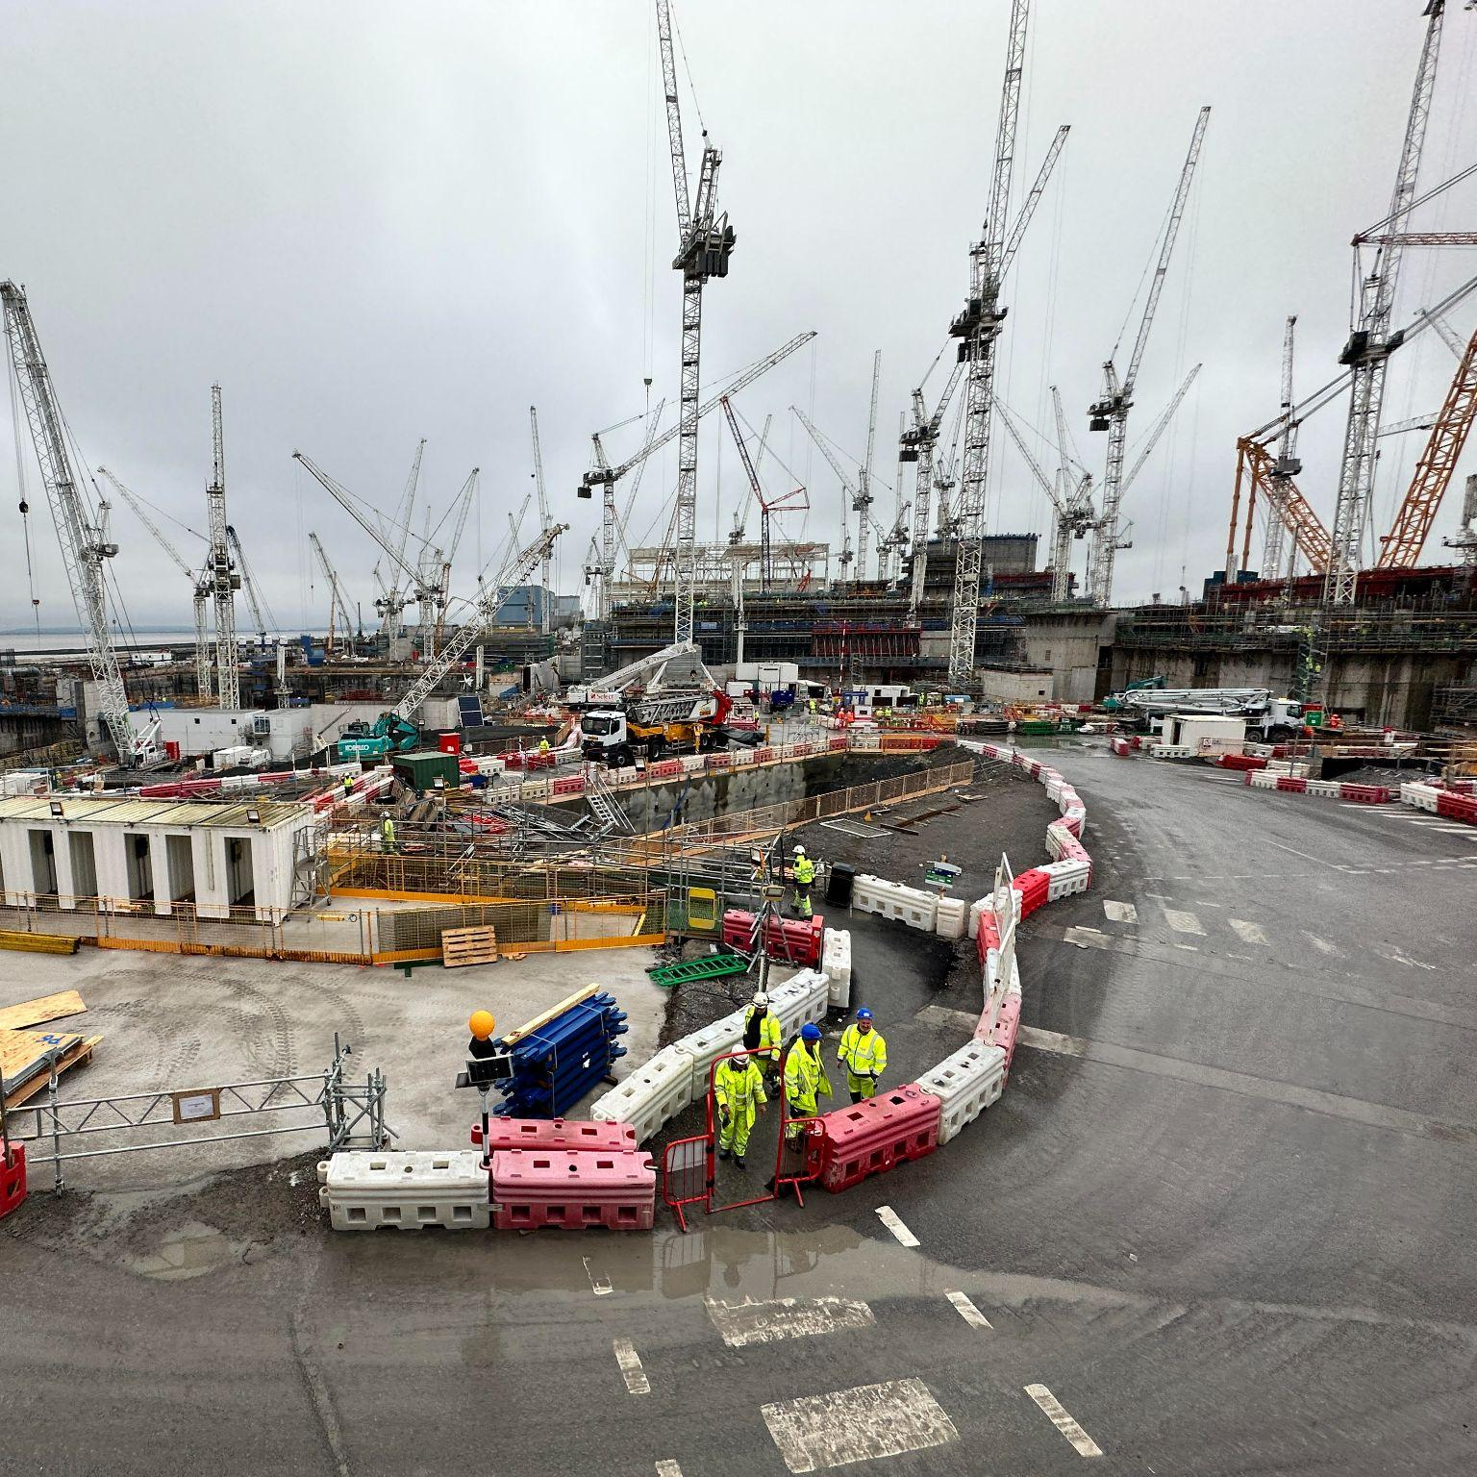
Salmon and Construction
Notes:
What do Salmon and a large construction site have in common? A quick story about how we used an AI Algorithm that tracked salmon based on their gate to reduce dwell times in queues to the canteens at HPC

Slide 4
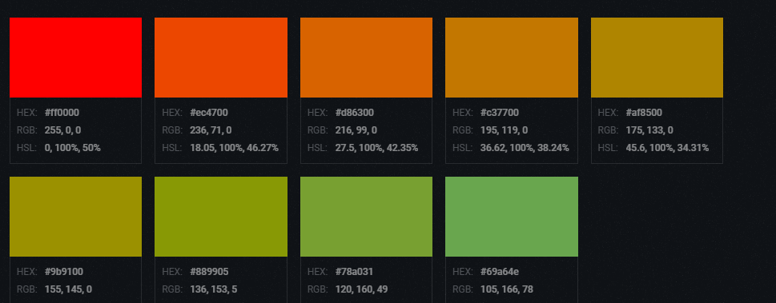
Countermeasure Spectrum
1
3
5
2
4
No-Tech
Low-Tech
High-Tech
6
7
8
9
Deter
8
7
8
8
Control Access
8
9
9
9
Detect
6
2
7
9
Assess
9
1
5
9
Delay
3
8
6
7
Respond
9
1
6
8
Communicate
9
1
7
9
Record
2
1
9
9
Notes:
This slide provides a systematic evaluation of different categories of physical security solutions—ranging from No-Tech, through Low-Tech, to High-Tech (both non-AI and AI-enabled)—in their effectiveness at achieving critical security effects: Deterrence, Access Control, Detection, Assessment, Delay, Response, Communication, and Recording. By scoring each solution type against these security objectives, the slide helps stakeholders understand the relative strengths and limitations of each approach within the security countermeasure spectrum.
It achieves several key objectives:
Clarifies the Role of Each Solution Type: It outlines how No-Tech, Low-Tech, High-Tech (non-AI), and High-Tech (AI-enabled) solutions contribute to a comprehensive security strategy, emphasizing the unique value and application of each category.
Guides Strategic Decision-Making: By providing a comparative analysis, the slide aids in making informed decisions about integrating and balancing different types of security solutions to address specific vulnerabilities and threats effectively.
Highlights the Importance of AI in Security: It showcases the enhanced capabilities brought by AI technology to High-Tech security solutions, particularly in assessing threats and automating responses, illustrating the technological advancement in security practices.
Facilitates Resource Allocation: Understanding the effectiveness of various security solutions across a spectrum of actions enables more efficient allocation of resources—whether financial, human, or technological—to areas where they are most needed or will have the greatest impact.
Educates Stakeholders: It serves as an educational tool for stakeholders, including security professionals, management, and technical teams, to understand the comprehensive landscape of physical security measures and their strategic implications.
Overall, the slide serves as a concise yet detailed overview, enabling stakeholders to strategize more effectively about incorporating diverse security measures into their overall security posture, balancing deterrence, detection, and response capabilities in a manner tailored to their specific context and needs.

Slide 5
OODA Loop
Act
Observe
Decide
Orient

Slide 6
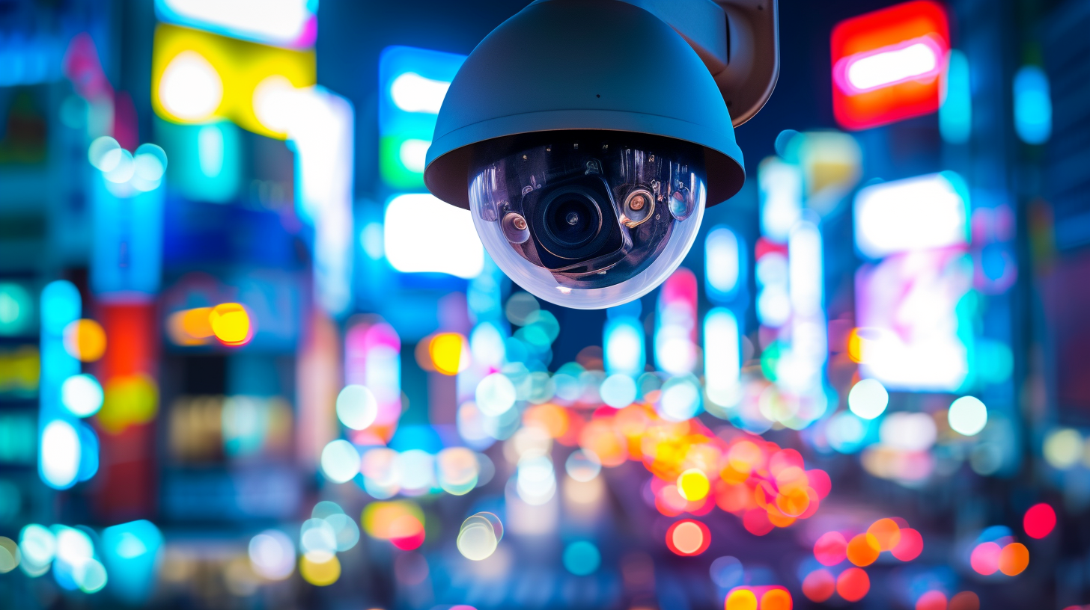
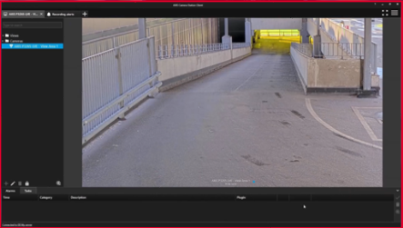
Surveillance and Detection
Enhanced Surveillance and Monitoring
Object Identification and Classification

Slide 7
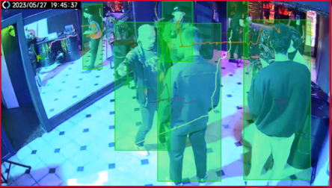
Surveillance and Detection
Enhanced Surveillance and Monitoring
Behaviour Analysis

Slide 8
Surveillance and Detection
Enhanced Surveillance and Monitoring
Facial Recognition

Slide 9
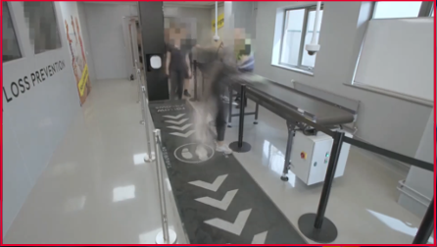
Surveillance and Detection
Enhanced Surveillance and Monitoring
Screening

Slide 10
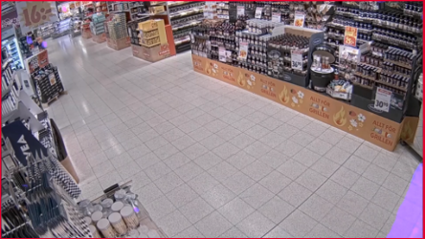
Surveillance and Detection
Enhanced Surveillance and Monitoring
Masking

Slide 11
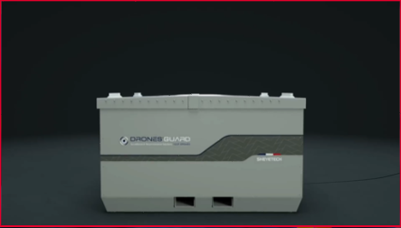
Surveillance and Detection
Enhanced Surveillance and Monitoring
Drones

Slide 12
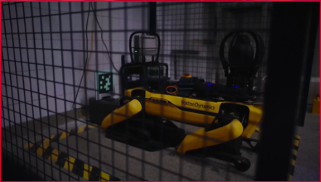
Surveillance and Detection
Enhanced Surveillance and Monitoring
Robotics

Slide 13
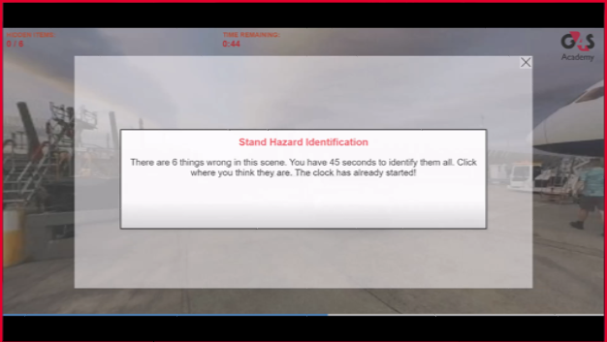
Operational Improvement
AI Enhanced Training Programmes
Virtual Reality

Slide 14
Operational Improvement
AI Enhanced Training Programmes
Avatars

Slide 15
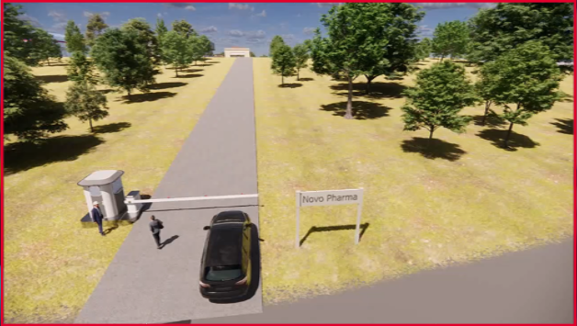
Operational Improvement
AI Enhanced Training Programmes
Scenario Based Training

